Slide 1
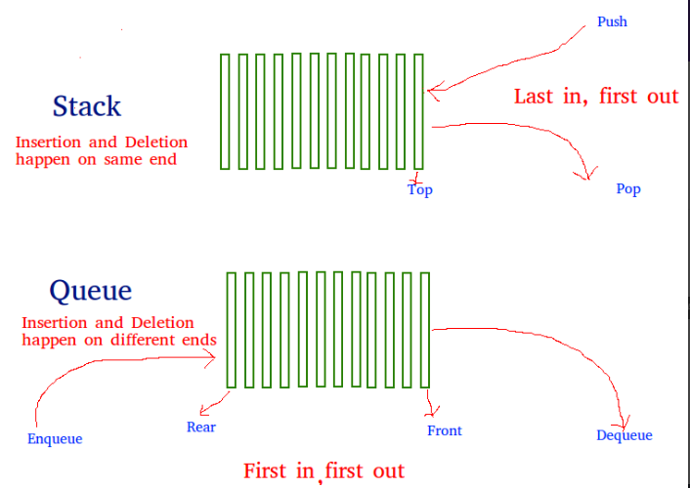
Stack using Queue
Stacks follow the Last-In-First-Out (LIFO) principle.
While queues follow the First-In-First-Out (FIFO) principle.
Stacks and queues are fundamental data structures used in computer science and programming While these data structures serve distinct purposes, there are situations where you may need to implement a stack using a queue.

Slide 2
Reasons
Efficiency
Space Optimization
Simplicity
Learning and Teaching
Implementing a stack using a queue is efficient, memory-saving, and simplifies code by leveraging the queue's efficient operations, saving space, and reducing complexity. Moreover, it serves as a valuable learning tool to understand data structure relationships and manipulation techniques.

Slide 3
Application
Expression Evaluation
Backtracking Algorithms
Resource Management
Undo/Redo Functionality
Algorithm Design
Stack using a queue has a wide range of practical applications. It is instrumental in scenarios such as expression evaluation, backtracking algorithms, resource management, undo/redo functionality, and algorithm design. This versatile approach allows for efficient problem-solving and enhanced functionality in various software and system development contexts.

Slide 4
Approaches
Making a push operation costly
The idea is to keep newly entered element at the front of ‘q1’ so that pop operation dequeues from ‘q1’. ‘q2’ is used to put every new element in front of ‘q1’.
Push Algorithm
Consider two queues, i.e., Q1 and Q2, and the element to be inserted in the queue is x.
if Q1.isEmpty() then
Q1.enqueue(x);
Else
size:= Q1.size();

Slide 5
for i=0…size do
Q2.enqueue(Q1.dequeue());
end
Q1.enqueue(x);
for j=0….size do
Q1.enqueue(Q2.dequeue());
end
Pop Algorithm
Consider two queues, i.e., Q1 and Q2, and we want to remove the element from the front of the queue.
item:= Q1.dequeue();
return item;

Slide 6
Making pop operation costly
The new element is always enqueued to q1. In pop() operation, if q2 is empty then all the elements except the last, are moved to q2. Finally, the last element is dequeued from q1 and returned.
Push Algorithm
Consider two queues, i.e., Q1 and Q2, and the element to be inserted in the queue is x.
element= Q1.enqueue(x);
return element;
Pop Algorithm
Consider two queues, i.e., Q1 and Q2, and we want to remove an element from the queue.
if !Q1.isEmpty() then
size:= Q1.size();

Slide 7
for i=0…size-1 do
Q2.enqueue(Q1.dequeue());
end
int item = Q1.dequeue();
for j=0…size-1 do
Q1.enqueue(Q2.dequeue());
end

